Slide 1
Computer Graphics
And
Physically Based Rendering
An Introduction

Slide 2
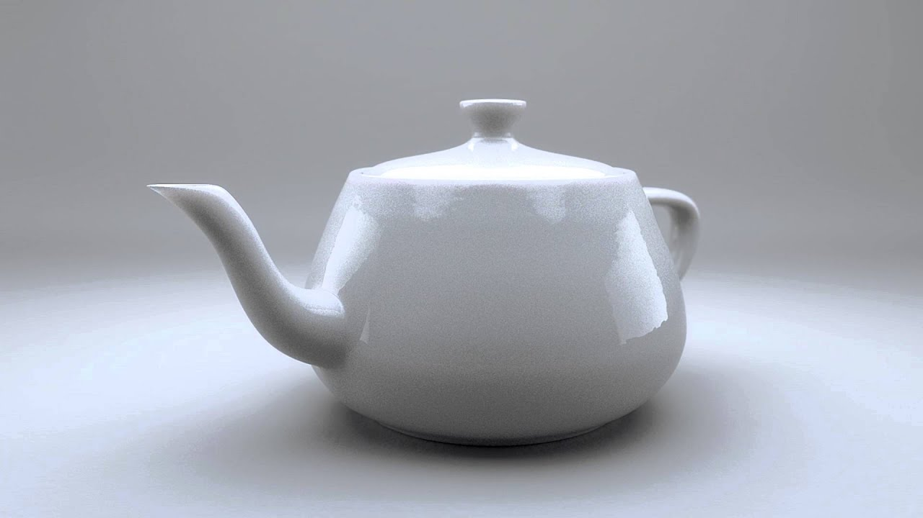
What is Computer Graphics
“Usually, the term refers to computer-generated image data created with the help of specialized graphical hardware and software.”
Wikipedia

Slide 3


What we’ll cover today
What drives CG ? Take a brief look at what industries drive CG
Two important rendering algorithms We’ll take a look at Rasterization and Ray Tracing. But our focus for today will be Ray Tracing.
A short coding exercise Together we’ll create our first image, and get a flavor of Graphics Programming

Slide 4
What drives
Computer Graphics?

Slide 5
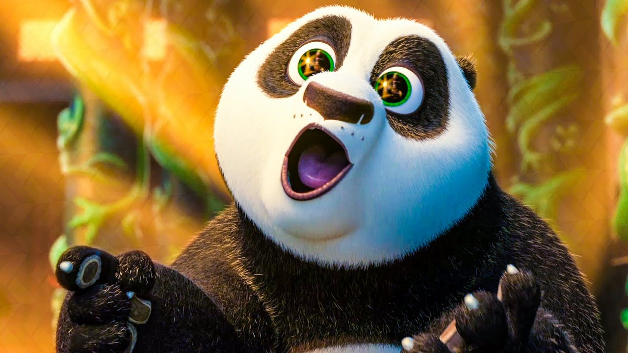

Movie Industry

Slide 6

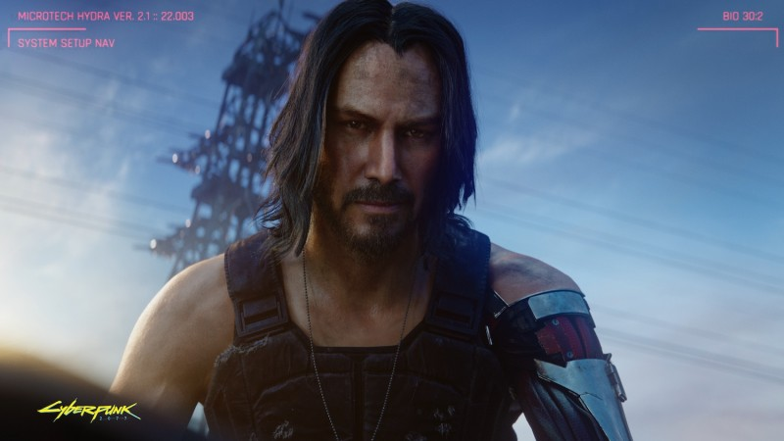
Game Industry

Slide 7
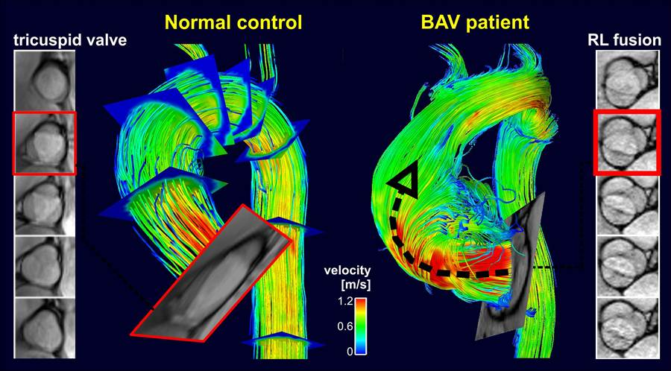
Medical Imaging and Scientific Visualization

Slide 8

Computer Aided Design

Slide 9
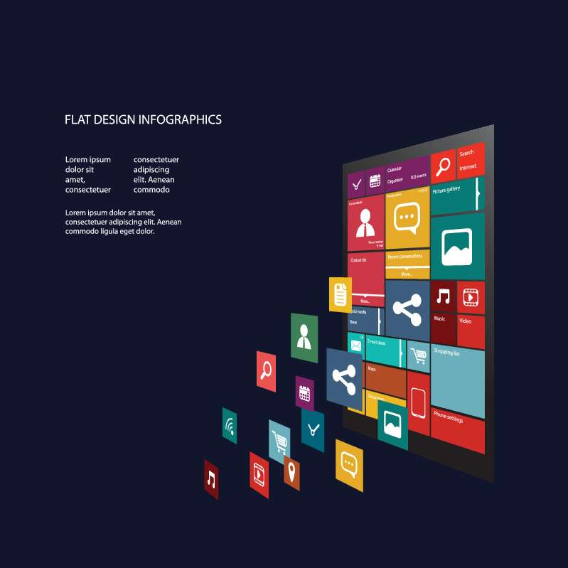
Graphical User Interface

Slide 10
What is Physically Based Rendering?
It is an approach that seeks to render graphics in a way that more accurately models the flow of light in the real world.

Slide 11


Slide 12
Photograph

Slide 13


Slide 14
CGI

Slide 15


Slide 16
CGI

Slide 17


Slide 18
Photograph

Slide 19


Slide 20
CGI

Slide 22
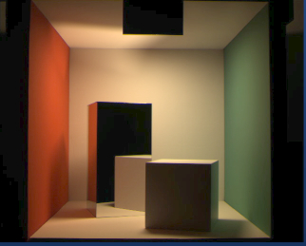
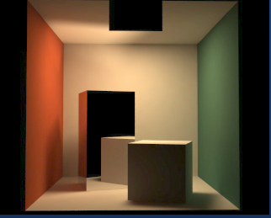

Slide 23
Photograph
CGI

Slide 24
Photograph
CGI

Slide 25
Rasterization
and Ray Tracing

Slide 26
What problem are we trying to solve?

Slide 27
What problem are we trying to solve?
Visibility and Shading

Slide 28
Both these algorithms solve the visibility problem, but in a different order.

Slide 29
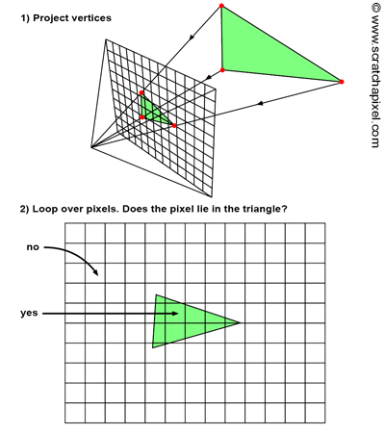
Rasterization

Slide 30
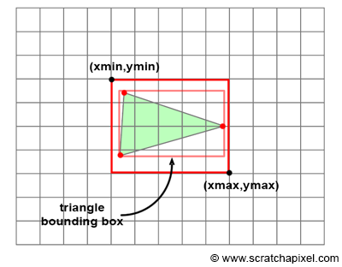

Slide 31
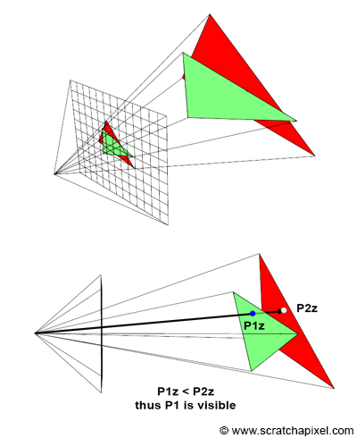

Slide 32
Ray Tracing
Simulate actual rays and how they interact with the environment.
Backward Tracing
Then cast shadow ray and secondary rays.
Using this method we can physically realistic images.

Slide 33
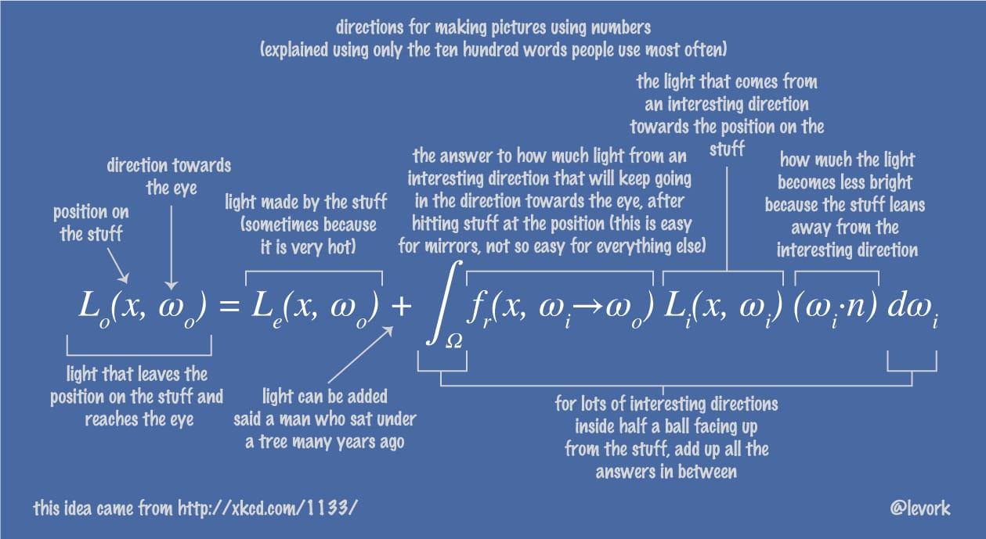
The infamous Rendering Equation

Slide 34
Ray Triangle Intersection
How would you approach it?

Slide 35
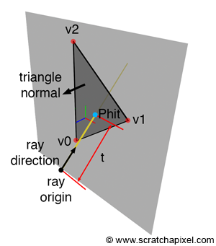
Ray Triangle Intersection

Slide 36
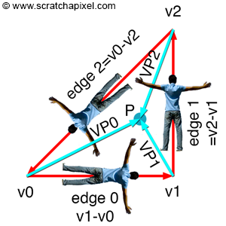
Ray Triangle Intersection

Slide 37
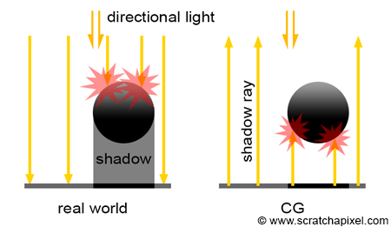
Shadow Rays

Slide 38
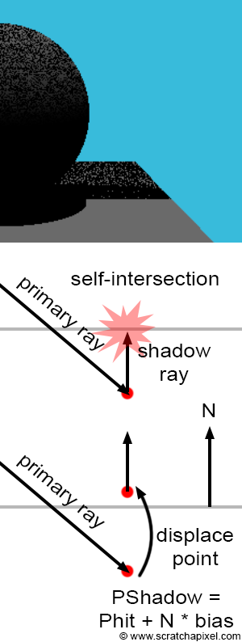
Self Intersection
Shadow Acne

Slide 39
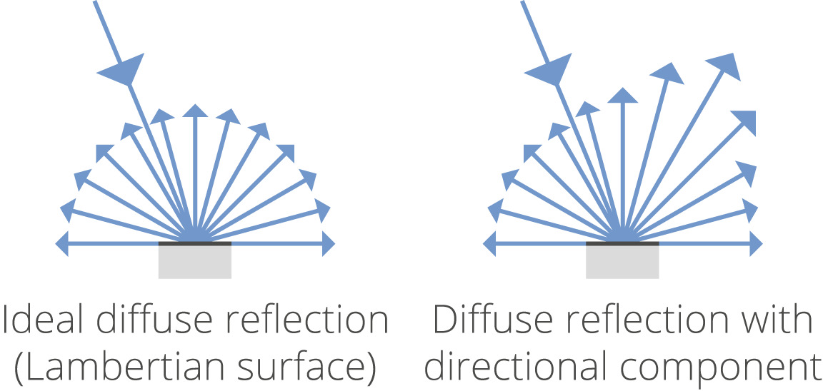
Lambertian Scattering

Slide 40
Lambertian Scattering
Scattering Density = Input Light / PI

Slide 41
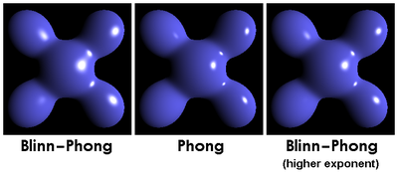
Glossy Scattering

Slide 42
Glossy Scattering
w_h = (w_i + w_o)
Scattering Density = Lambertian Color + (Glossy Color) x (s+8.0) x pow(max(0, w_h.dot(normal)), s)/8
Lambertian + Glossy < 1
To ensure energy conservation.
s is Glossy Sharpness [0, 2000] in logarithmic scale

Slide 43
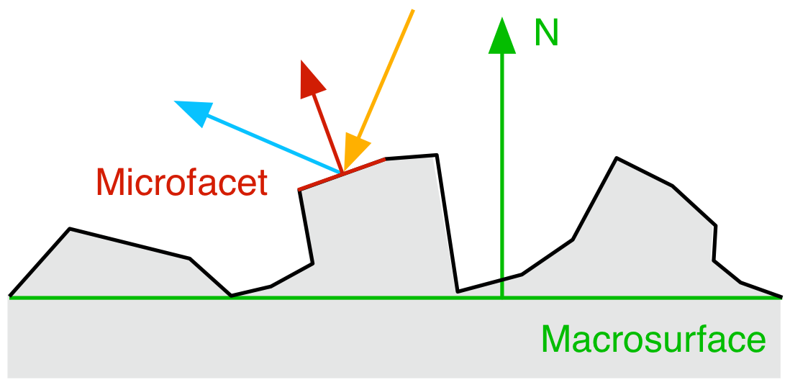
Microfacet Theory
Both diffuse and specular reflection depend on surface irregularities.
Previous models ignore this.

Slide 44
Global Illumination
This algorithm takes care not only the light that directly comes from the light sources, but also subsequent cases in which light rays from the same source are reflected by other surfaces in the scene whether reflective or not.

Slide 45
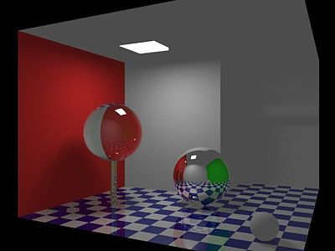
Global Illumination
Without GI

Slide 46
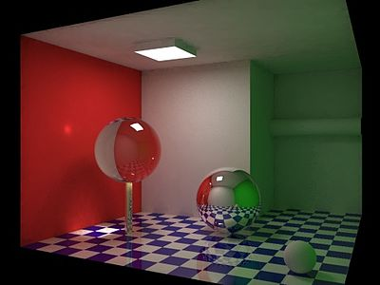
Global Illumination
With GI

Slide 47
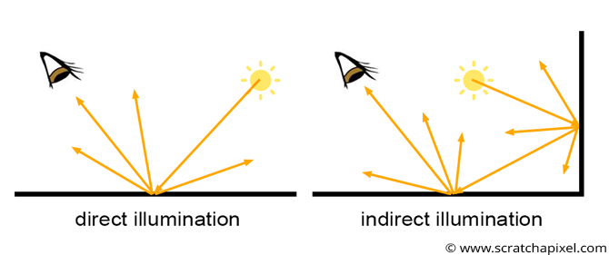
Global Illumination

Slide 48
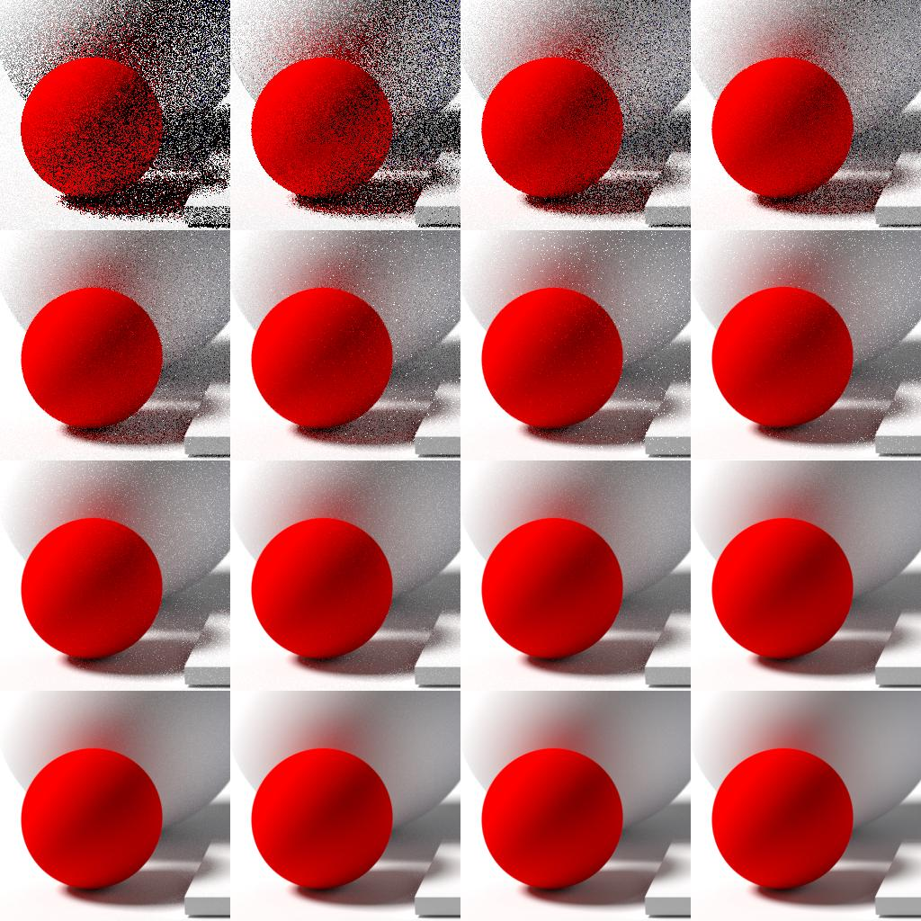
Noise

Slide 49
Some Render Engines
Arnold (coupled with Autodesk Maya/3DS Max)
Redshift
Octane Render
RenderMan (In-house render engine at PIXAR)
Hyperion (In-house render engine at Disney)
Cycles (coupled with Blender, Open Source)
appleseed (Open Source, with plugins for Blender, Maya, and 3DS Max)
Mitsuba (Open Source, Research Oriented)

Slide 50

There’s much more to CGI than what we’ve seen today!
This isn’t even the tip of the iceberg.

Slide 51
Now that you’ve seen what goes into creating CGI, you might start appreciating the field.
Some resources for those interested:
https://www.scratchapixel.com/
https://learnopengl.com/
Physically Based Rendering From Theory to Implementation http://www.pbr-book.org/
Computer Graphics Principles and Practice by Foley, et. al https://wow.link/9F6
Let’s move to the coding exercise and create our first image together! Clone the following repo: https://github.com/KarthikRIyer/MDG-CG-lecture

